Slide 1
Self Organized Criticality
Marienne Faro & Tim Gebraad
28 – 07 – 16
Notes:
M [? min]
the presentation consist of the following part
thereafter the developed model will be discussed.
Introduction
Good Afternoon. Welcome to our bachelor thesis presentation. My name is Marienne Faro and this is Tim Gebraad. Like you could have seen from the title we are going to talk about transmission at nanoscale.
Specifically, we are going to talk about transmission of graphene. The interest in graphene rises from its 2D crystal structure. Graphene can be reduced to very small structures without losing its electronic properties and the possibility to control the mobility of the electrons by an induced voltage. This property of graphene gives it enormous potential for technological applications.
We want to study the effect of doping the molecules with nitrogen and boron.
specifically we want to study the junction between doping with these two impurities, which form a p-n junction. The conventional diode is based on this unction. We want to look at the I-V curves from these junctions to conclude if they depict diode like behaviour.

Slide 2
Introduction
Sandpile
Traffic Jams
Evolution
Conclusion
Self Organized Criticality
Attractor state
Fractals
Powerlaw relations
1/f Noise
3 Different models:
Sandpile
Traffic jams
Bak-sneppen model of evolution
Notes:
M [? Min]
The purpose of our project was to develop a tool that can do very fast calculations on transmission. Also the tool had to be interactive, so the user can alter the input and get almost real-time feed back.
This can then be used to investigate molecules and search for promising compositions.
The second part of the project we have used the developed tool to look at graphene nanoribbons, because of their simple 2D structure and the relativistic behavior of the electrons. These nanoribbons could possibly be used in the transistor industry if their properties can be understood and controlled by for example doping.
But before looking into this a proper understanding of the underlying formalisms is required.

Slide 3

Introduction
Sandpile
Model
Initialization
Fractals
Scales
Noise
Traffic Jams
Evolution
Conclusion
Sandpile Model
Introduction
Theory
System
NEGF
Transmission
Model
Results
Conclusion
Find Z(x,y) > Z_{crit}
Z(x,y) – = 4
Z(x-1,y) +=1
Z(x+1,y) +=1
Z(x,y-1) +=1
Z(x,y+1) +=1
Notes:
M [? Min]
The purpose of our project was to develop a tool that can do very fast calculations on transmission. Also the tool had to be interactive, so the user can alter the input and get almost real-time feed back.
This can then be used to investigate molecules and search for promising compositions.
The second part of the project we have used the developed tool to look at graphene nanoribbons, because of their simple 2D structure and the relativistic behavior of the electrons. These nanoribbons could possibly be used in the transistor industry if their properties can be understood and controlled by for example doping.
But before looking into this a proper understanding of the underlying formalisms is required.

Slide 4
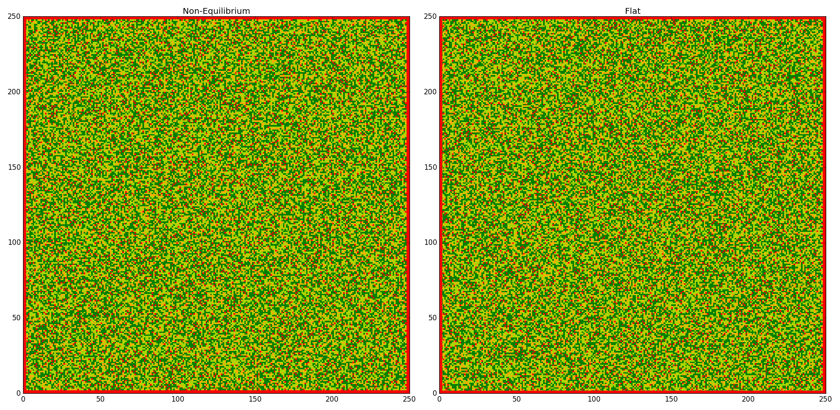
Introduction
Sandpile
Model
Initialization
Fractals
Scales
Noise
Traffic Jams
Evolution
Conclusion
Attractor state
Notes:
M [? Min]
The purpose of our project was to develop a tool that can do very fast calculations on transmission. Also the tool had to be interactive, so the user can alter the input and get almost real-time feed back.
This can then be used to investigate molecules and search for promising compositions.
The second part of the project we have used the developed tool to look at graphene nanoribbons, because of their simple 2D structure and the relativistic behavior of the electrons. These nanoribbons could possibly be used in the transistor industry if their properties can be understood and controlled by for example doping.
But before looking into this a proper understanding of the underlying formalisms is required.

Slide 5
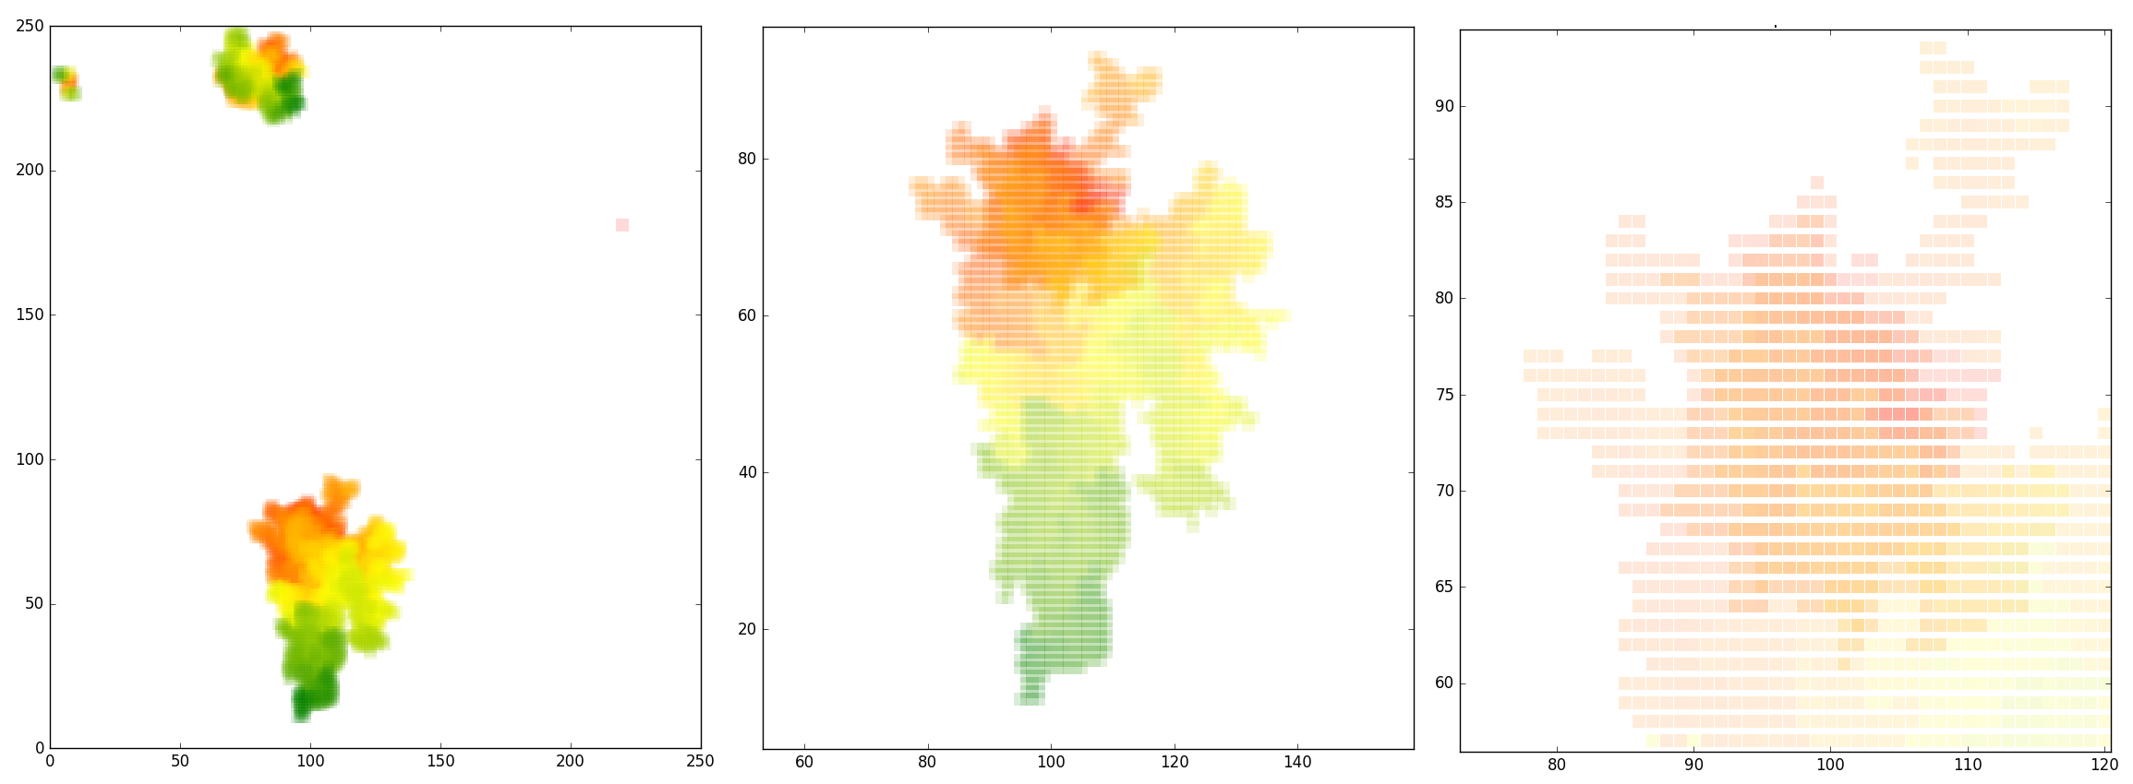
Introduction
Sandpile
Model
Initialization
Fractals
Scales
Noise
Traffic Jams
Evolution
Conclusion
Fractals
Notes:
M [? Min]
The purpose of our project was to develop a tool that can do very fast calculations on transmission. Also the tool had to be interactive, so the user can alter the input and get almost real-time feed back.
This can then be used to investigate molecules and search for promising compositions.
The second part of the project we have used the developed tool to look at graphene nanoribbons, because of their simple 2D structure and the relativistic behavior of the electrons. These nanoribbons could possibly be used in the transistor industry if their properties can be understood and controlled by for example doping.
But before looking into this a proper understanding of the underlying formalisms is required.

Slide 6
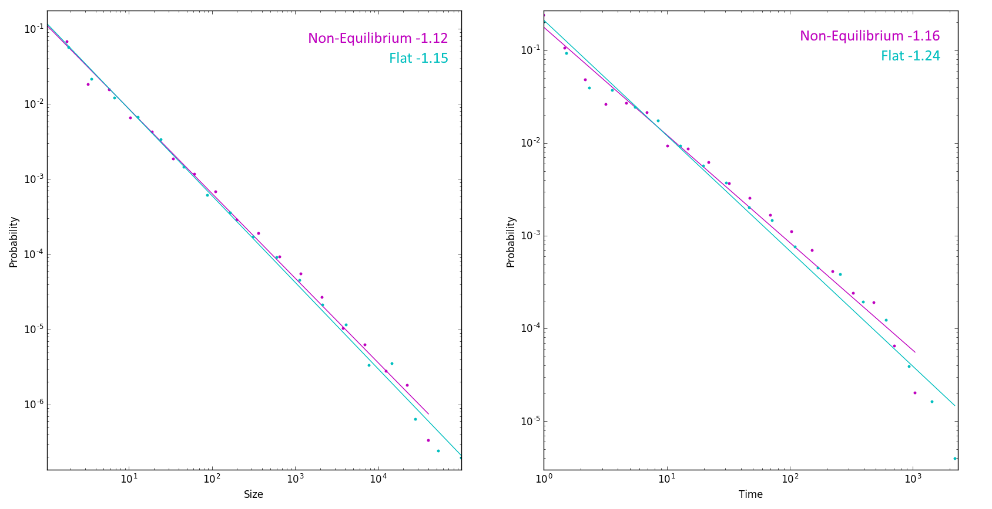
Introduction
Sandpile
Model
Initialization
Fractals
Scales
Noise
Traffic Jams
Evolution
Conclusion
Scales
Notes:
M [? Min]
The purpose of our project was to develop a tool that can do very fast calculations on transmission. Also the tool had to be interactive, so the user can alter the input and get almost real-time feed back.
This can then be used to investigate molecules and search for promising compositions.
The second part of the project we have used the developed tool to look at graphene nanoribbons, because of their simple 2D structure and the relativistic behavior of the electrons. These nanoribbons could possibly be used in the transistor industry if their properties can be understood and controlled by for example doping.
But before looking into this a proper understanding of the underlying formalisms is required.

Slide 7
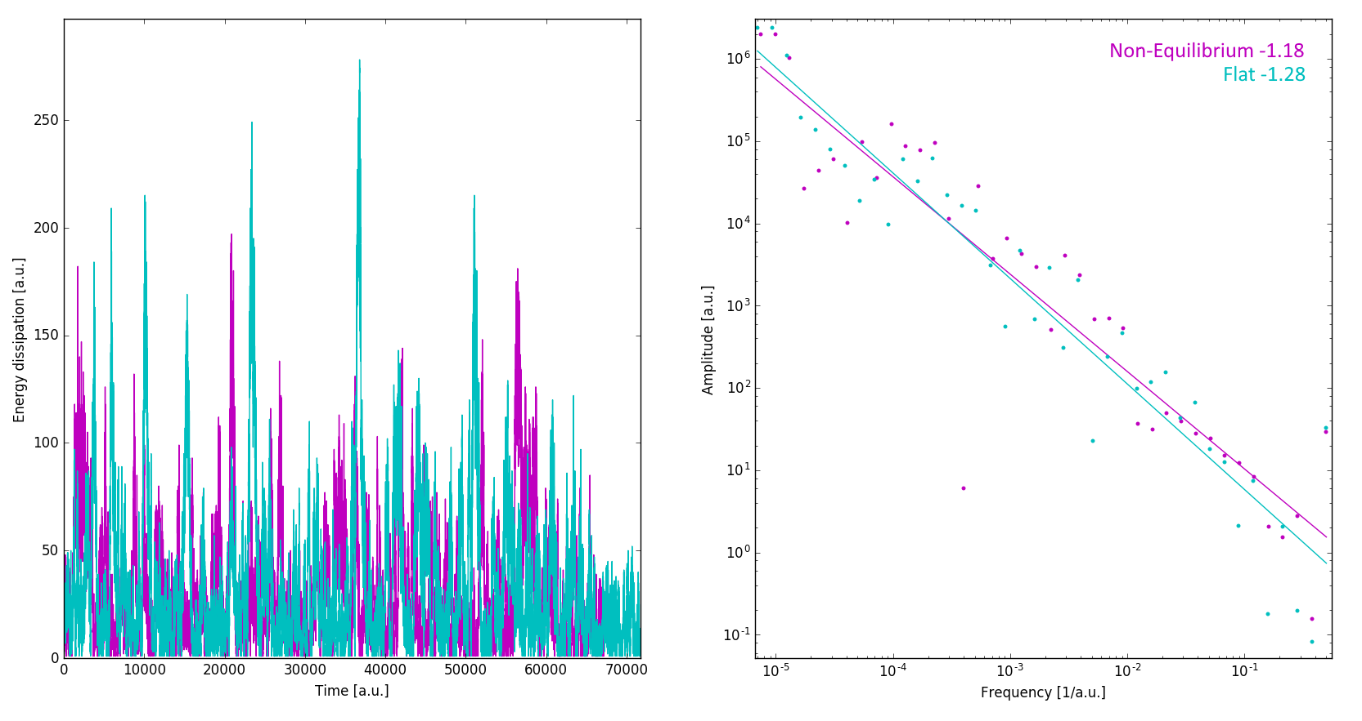
Introduction
Sandpile
Model
Initialization
Fractals
Scales
Noise
Traffic Jams
Evolution
Conclusion
Energy dissipation
Notes:
M [? Min]
The purpose of our project was to develop a tool that can do very fast calculations on transmission. Also the tool had to be interactive, so the user can alter the input and get almost real-time feed back.
This can then be used to investigate molecules and search for promising compositions.
The second part of the project we have used the developed tool to look at graphene nanoribbons, because of their simple 2D structure and the relativistic behavior of the electrons. These nanoribbons could possibly be used in the transistor industry if their properties can be understood and controlled by for example doping.
But before looking into this a proper understanding of the underlying formalisms is required.

Slide 8
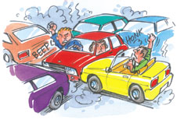
Introduction
Sandpile
Traffic Jams
Model
Initialization
Reality
Fractals
Scales
Noise
Evolution
Conclusion
Traffic jams
Acceleration
Slowing down
Randomization
Car motion
Notes:
M [? Min]
The purpose of our project was to develop a tool that can do very fast calculations on transmission. Also the tool had to be interactive, so the user can alter the input and get almost real-time feed back.
This can then be used to investigate molecules and search for promising compositions.
The second part of the project we have used the developed tool to look at graphene nanoribbons, because of their simple 2D structure and the relativistic behavior of the electrons. These nanoribbons could possibly be used in the transistor industry if their properties can be understood and controlled by for example doping.
But before looking into this a proper understanding of the underlying formalisms is required.

Slide 9
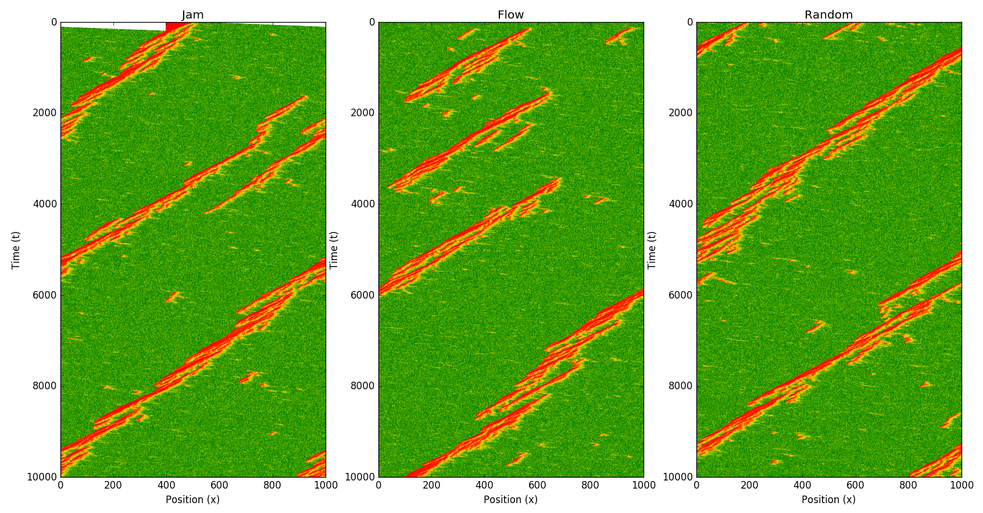
Introduction
Sandpile
Traffic Jams
Model
Initialization
Reality
Fractals
Scales
Noise
Evolution
Conclusion
Attractor state
Notes:
M [? Min]
The purpose of our project was to develop a tool that can do very fast calculations on transmission. Also the tool had to be interactive, so the user can alter the input and get almost real-time feed back.
This can then be used to investigate molecules and search for promising compositions.
The second part of the project we have used the developed tool to look at graphene nanoribbons, because of their simple 2D structure and the relativistic behavior of the electrons. These nanoribbons could possibly be used in the transistor industry if their properties can be understood and controlled by for example doping.
But before looking into this a proper understanding of the underlying formalisms is required.

Slide 10
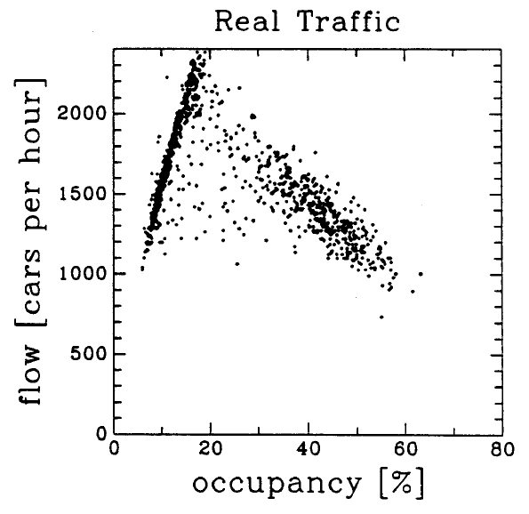
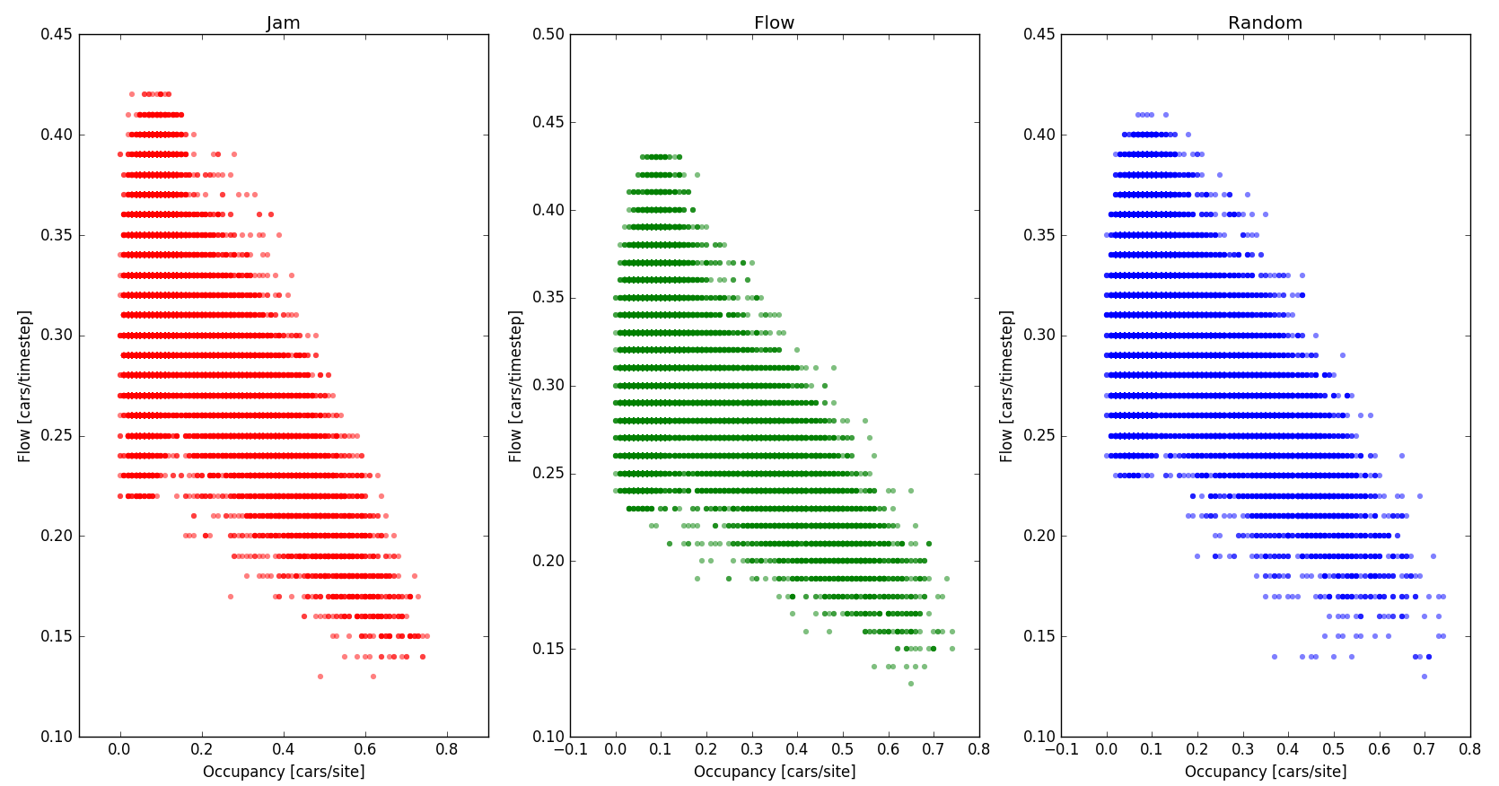
Introduction
Sandpile
Traffic Jams
Model
Initialization
Reality
Fractals
Scales
Noise
Evolution
Conclusion
Occupancy vs flow
Notes:
M [? Min]
The purpose of our project was to develop a tool that can do very fast calculations on transmission. Also the tool had to be interactive, so the user can alter the input and get almost real-time feed back.
This can then be used to investigate molecules and search for promising compositions.
The second part of the project we have used the developed tool to look at graphene nanoribbons, because of their simple 2D structure and the relativistic behavior of the electrons. These nanoribbons could possibly be used in the transistor industry if their properties can be understood and controlled by for example doping.
But before looking into this a proper understanding of the underlying formalisms is required.

Slide 11
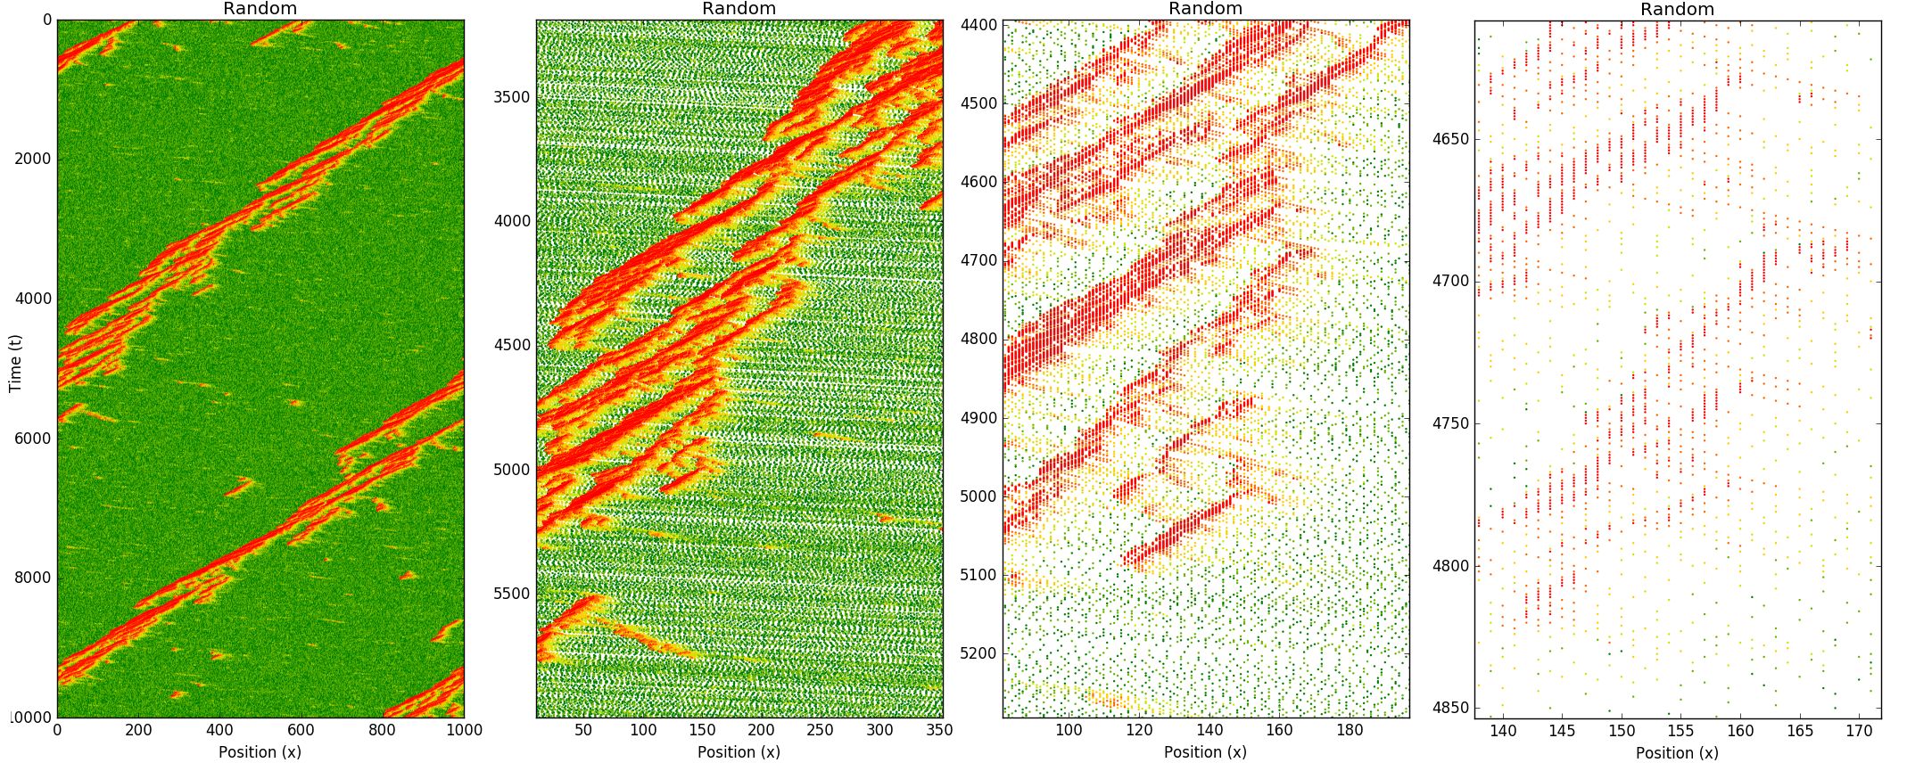
Introduction
Sandpile
Traffic Jams
Model
Initialization
Reality
Fractals
Scales
Noise
Evolution
Conclusion
Fractals
Notes:
M [? Min]
The purpose of our project was to develop a tool that can do very fast calculations on transmission. Also the tool had to be interactive, so the user can alter the input and get almost real-time feed back.
This can then be used to investigate molecules and search for promising compositions.
The second part of the project we have used the developed tool to look at graphene nanoribbons, because of their simple 2D structure and the relativistic behavior of the electrons. These nanoribbons could possibly be used in the transistor industry if their properties can be understood and controlled by for example doping.
But before looking into this a proper understanding of the underlying formalisms is required.

Slide 12
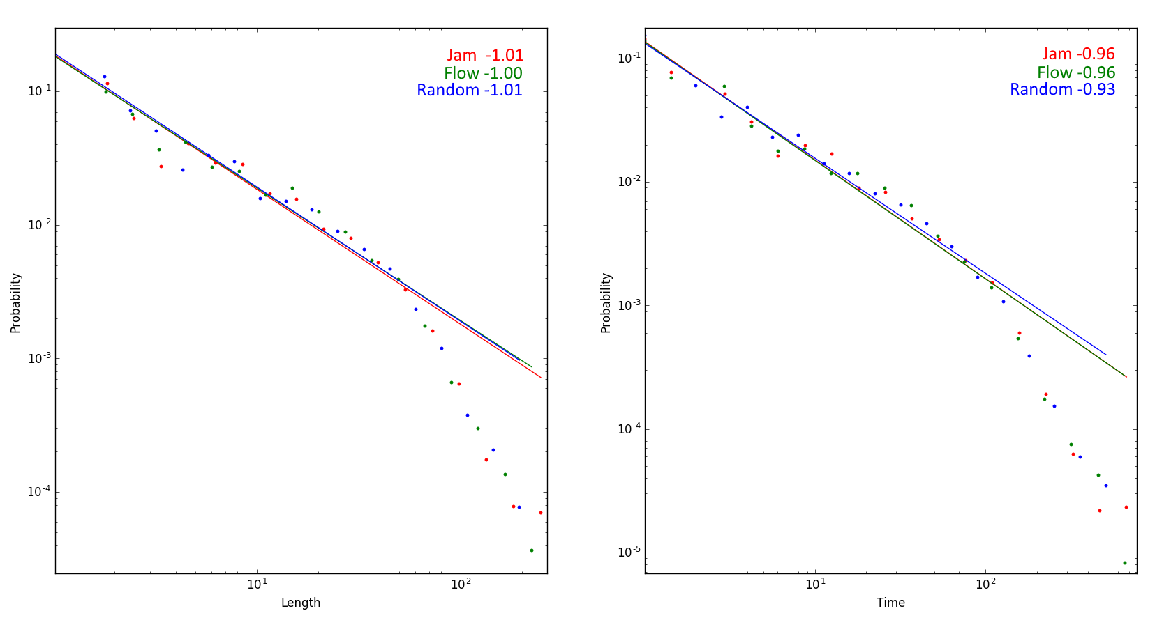
Introduction
Sandpile
Traffic Jams
Model
Initialization
Reality
Fractals
Scales
Noise
Evolution
Conclusion
Scales
Notes:
M [? Min]
The purpose of our project was to develop a tool that can do very fast calculations on transmission. Also the tool had to be interactive, so the user can alter the input and get almost real-time feed back.
This can then be used to investigate molecules and search for promising compositions.
The second part of the project we have used the developed tool to look at graphene nanoribbons, because of their simple 2D structure and the relativistic behavior of the electrons. These nanoribbons could possibly be used in the transistor industry if their properties can be understood and controlled by for example doping.
But before looking into this a proper understanding of the underlying formalisms is required.

Slide 13
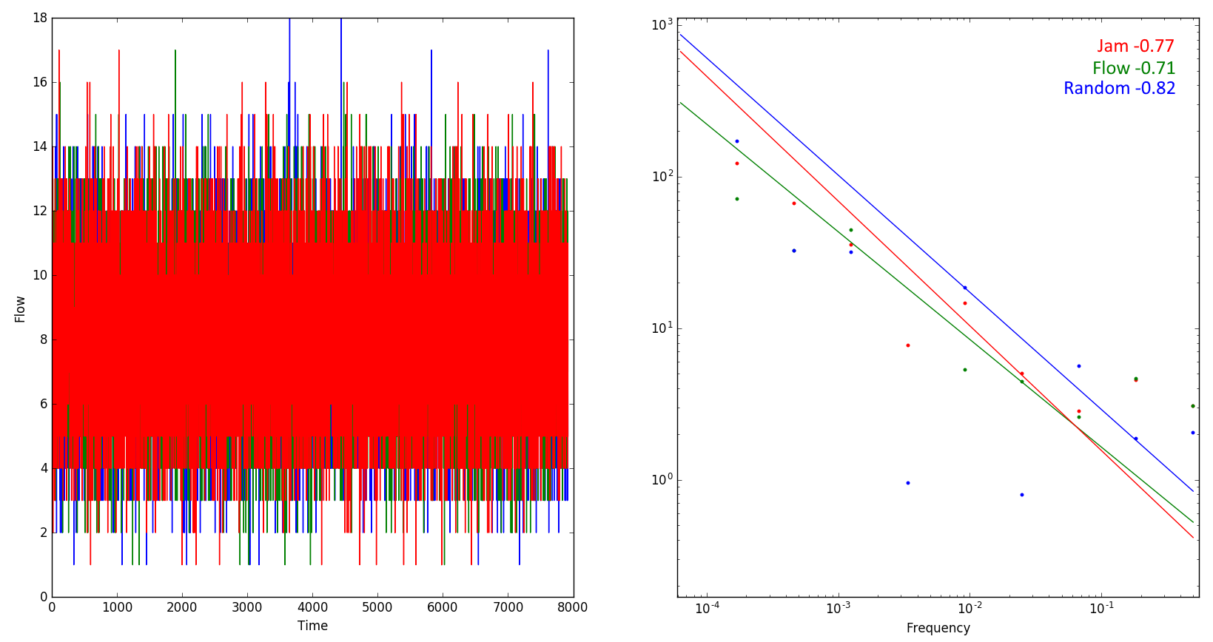
Introduction
Sandpile
Traffic Jams
Model
Initialization
Reality
Fractals
Scales
Noise
Evolution
Conclusion
Flow in time
Notes:
M [? Min]
The purpose of our project was to develop a tool that can do very fast calculations on transmission. Also the tool had to be interactive, so the user can alter the input and get almost real-time feed back.
This can then be used to investigate molecules and search for promising compositions.
The second part of the project we have used the developed tool to look at graphene nanoribbons, because of their simple 2D structure and the relativistic behavior of the electrons. These nanoribbons could possibly be used in the transistor industry if their properties can be understood and controlled by for example doping.
But before looking into this a proper understanding of the underlying formalisms is required.

Slide 14
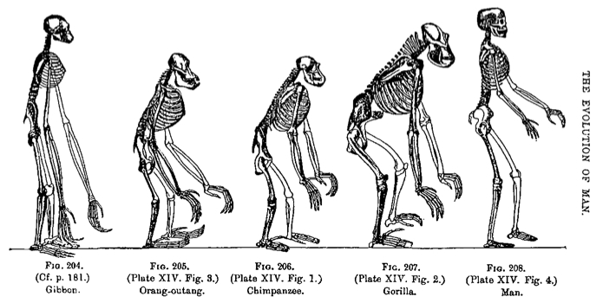
Introduction
Sandpile
Traffic Jams
Evolution
Model
Initialization
Attractor
Fractals
Scales
Noise
Conclusion
Bak-sneppen model of evolution
Each species (N) is represented
by its total fitness,
between 0 and 1.
Periodic boundary conditions
Model :
Find species with minumum fitness and randomly change its fitness
Simultanously change the immediate neighbors fitness randomly
Notes:
M [? Min]
The purpose of our project was to develop a tool that can do very fast calculations on transmission. Also the tool had to be interactive, so the user can alter the input and get almost real-time feed back.
This can then be used to investigate molecules and search for promising compositions.
The second part of the project we have used the developed tool to look at graphene nanoribbons, because of their simple 2D structure and the relativistic behavior of the electrons. These nanoribbons could possibly be used in the transistor industry if their properties can be understood and controlled by for example doping.
But before looking into this a proper understanding of the underlying formalisms is required.

Slide 15
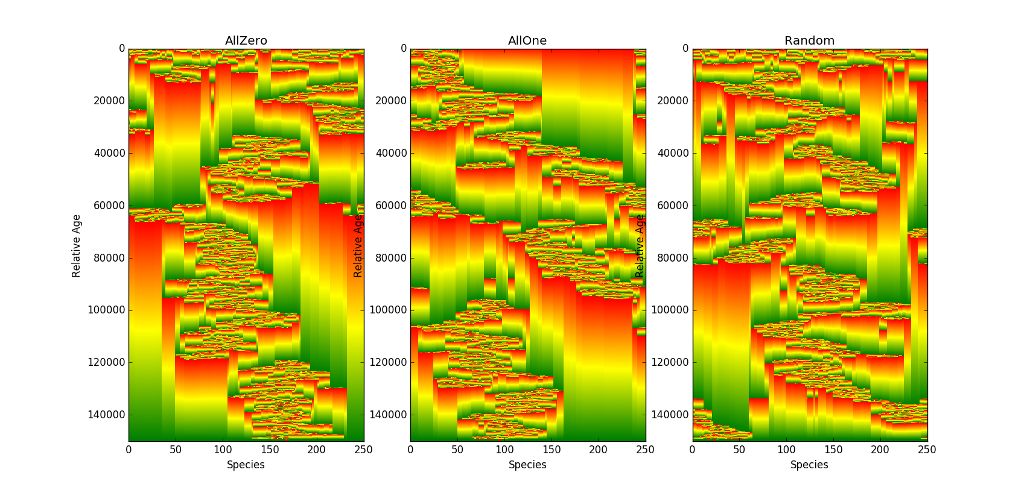
Introduction
Sandpile
Traffic Jams
Evolution
Model
Initialization
Attractor
Fractals
Scales
Noise
Conclusion
Attractor state
Notes:
M [? Min]
The purpose of our project was to develop a tool that can do very fast calculations on transmission. Also the tool had to be interactive, so the user can alter the input and get almost real-time feed back.
This can then be used to investigate molecules and search for promising compositions.
The second part of the project we have used the developed tool to look at graphene nanoribbons, because of their simple 2D structure and the relativistic behavior of the electrons. These nanoribbons could possibly be used in the transistor industry if their properties can be understood and controlled by for example doping.
But before looking into this a proper understanding of the underlying formalisms is required.

Slide 16
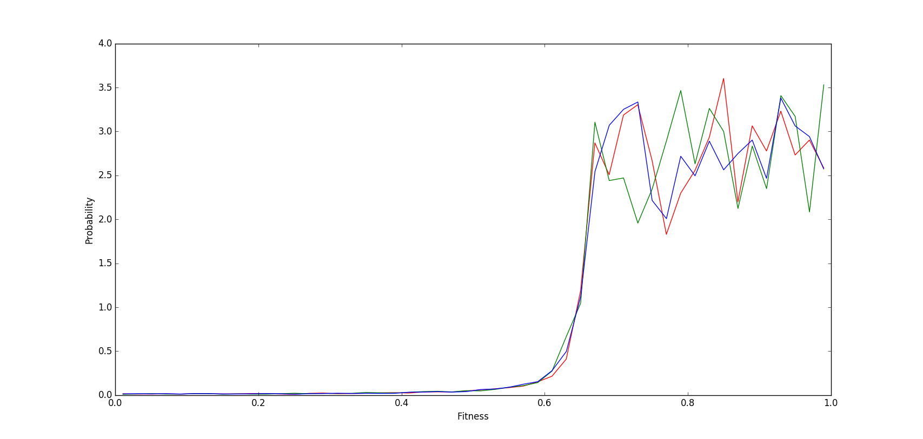
Introduction
Sandpile
Traffic Jams
Evolution
Model
Initialization
Attractor
Fractals
Scales
Noise
Conclusion
Attractor state
Notes:
M [? Min]
The purpose of our project was to develop a tool that can do very fast calculations on transmission. Also the tool had to be interactive, so the user can alter the input and get almost real-time feed back.
This can then be used to investigate molecules and search for promising compositions.
The second part of the project we have used the developed tool to look at graphene nanoribbons, because of their simple 2D structure and the relativistic behavior of the electrons. These nanoribbons could possibly be used in the transistor industry if their properties can be understood and controlled by for example doping.
But before looking into this a proper understanding of the underlying formalisms is required.

Slide 17
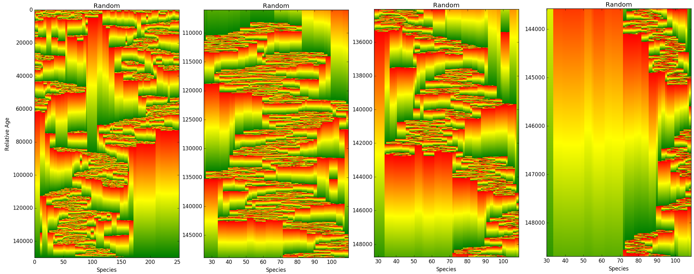
Introduction
Sandpile
Traffic Jams
Evolution
Model
Initialization
Attractor
Fractals
Scales
Noise
Conclusion
Fractals
Notes:
M [? Min]
The purpose of our project was to develop a tool that can do very fast calculations on transmission. Also the tool had to be interactive, so the user can alter the input and get almost real-time feed back.
This can then be used to investigate molecules and search for promising compositions.
The second part of the project we have used the developed tool to look at graphene nanoribbons, because of their simple 2D structure and the relativistic behavior of the electrons. These nanoribbons could possibly be used in the transistor industry if their properties can be understood and controlled by for example doping.
But before looking into this a proper understanding of the underlying formalisms is required.

Slide 18
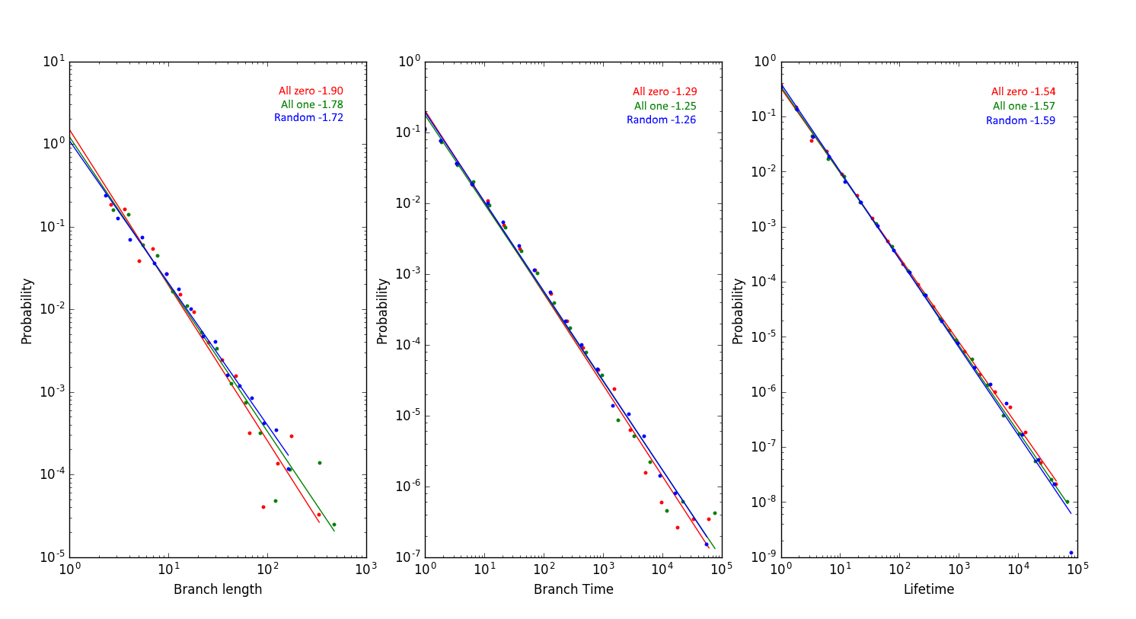
Introduction
Sandpile
Traffic Jams
Evolution
Model
Initialization
Attractor
Fractals
Scales
Noise
Conclusion
Scales
Notes:
M [? Min]
The purpose of our project was to develop a tool that can do very fast calculations on transmission. Also the tool had to be interactive, so the user can alter the input and get almost real-time feed back.
This can then be used to investigate molecules and search for promising compositions.
The second part of the project we have used the developed tool to look at graphene nanoribbons, because of their simple 2D structure and the relativistic behavior of the electrons. These nanoribbons could possibly be used in the transistor industry if their properties can be understood and controlled by for example doping.
But before looking into this a proper understanding of the underlying formalisms is required.

Slide 19
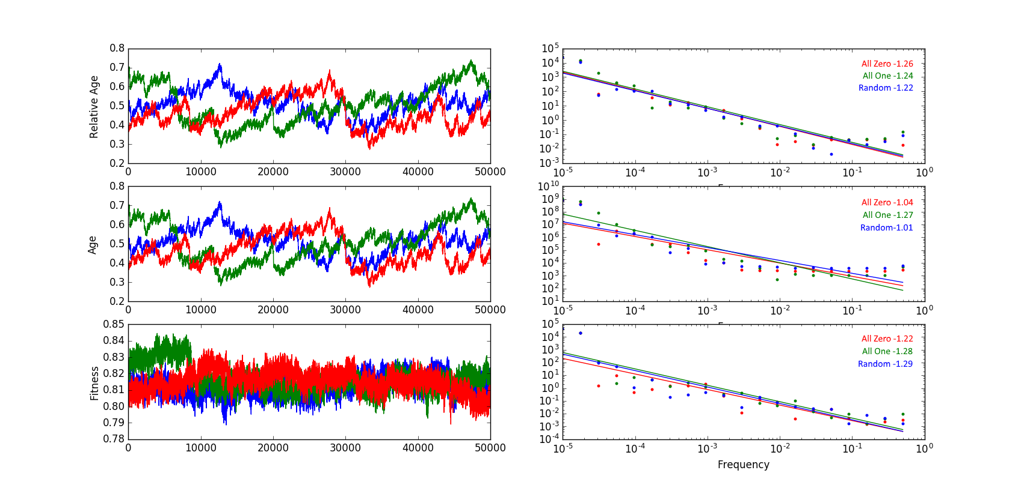
Introduction
Sandpile
Traffic Jams
Evolution
Model
Initialization
Attractor
Fractals
Scales
Noise
Conclusion
Time and frequency behavior
Notes:
M [? Min]
The purpose of our project was to develop a tool that can do very fast calculations on transmission. Also the tool had to be interactive, so the user can alter the input and get almost real-time feed back.
This can then be used to investigate molecules and search for promising compositions.
The second part of the project we have used the developed tool to look at graphene nanoribbons, because of their simple 2D structure and the relativistic behavior of the electrons. These nanoribbons could possibly be used in the transistor industry if their properties can be understood and controlled by for example doping.
But before looking into this a proper understanding of the underlying formalisms is required.

Slide 20
Introduction
Sandpile
Traffic Jams
Evolution
Conclusion
Conclusion
Systems behave self-organized criticality
Reproduce properties of real systems
Nature ->>> self-organized critical!!!!
Notes:
M [? Min]
The purpose of our project was to develop a tool that can do very fast calculations on transmission. Also the tool had to be interactive, so the user can alter the input and get almost real-time feed back.
This can then be used to investigate molecules and search for promising compositions.
The second part of the project we have used the developed tool to look at graphene nanoribbons, because of their simple 2D structure and the relativistic behavior of the electrons. These nanoribbons could possibly be used in the transistor industry if their properties can be understood and controlled by for example doping.
But before looking into this a proper understanding of the underlying formalisms is required.

Slide 21
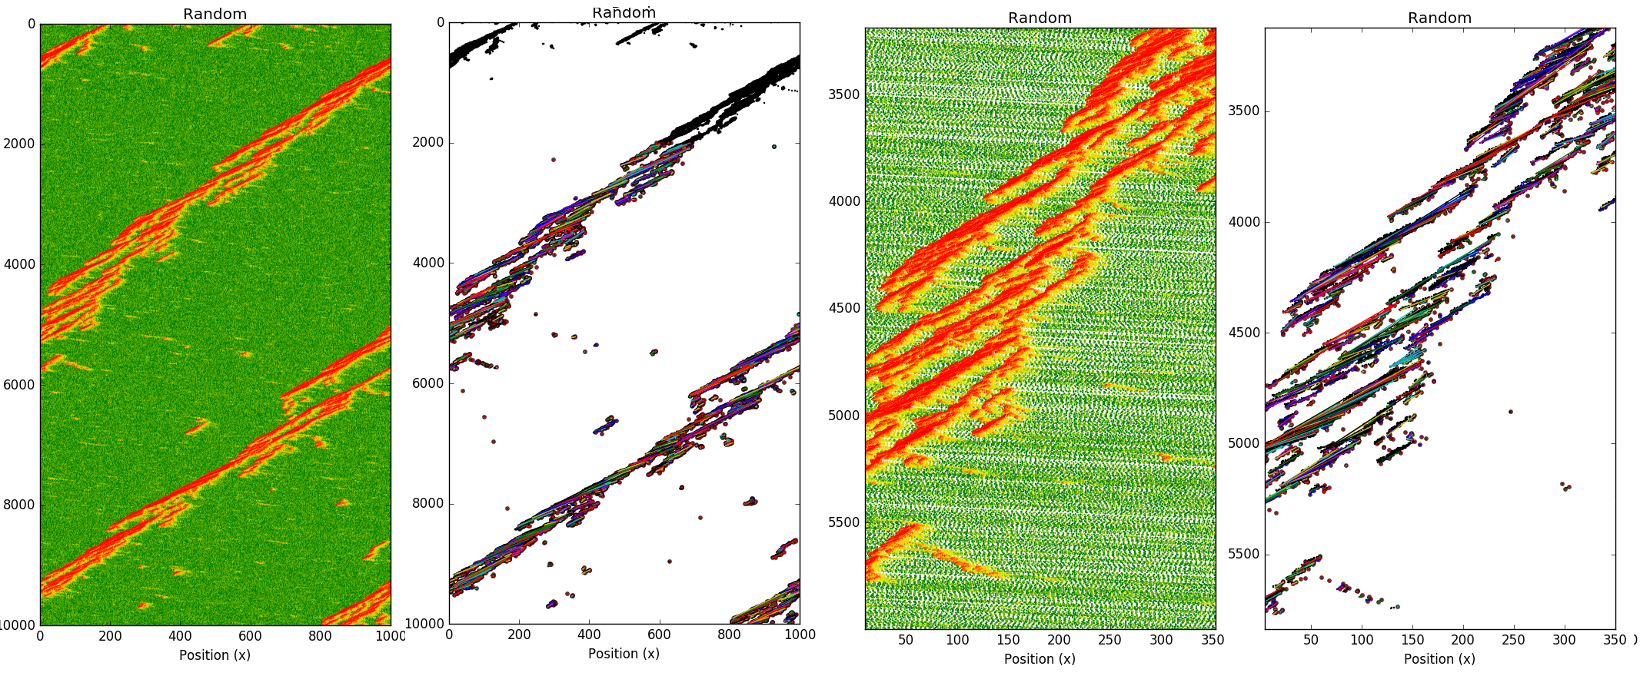
Determination Traffic Jams
Notes:
M [? Min]
The purpose of our project was to develop a tool that can do very fast calculations on transmission. Also the tool had to be interactive, so the user can alter the input and get almost real-time feed back.
This can then be used to investigate molecules and search for promising compositions.
The second part of the project we have used the developed tool to look at graphene nanoribbons, because of their simple 2D structure and the relativistic behavior of the electrons. These nanoribbons could possibly be used in the transistor industry if their properties can be understood and controlled by for example doping.
But before looking into this a proper understanding of the underlying formalisms is required.

Slide 22
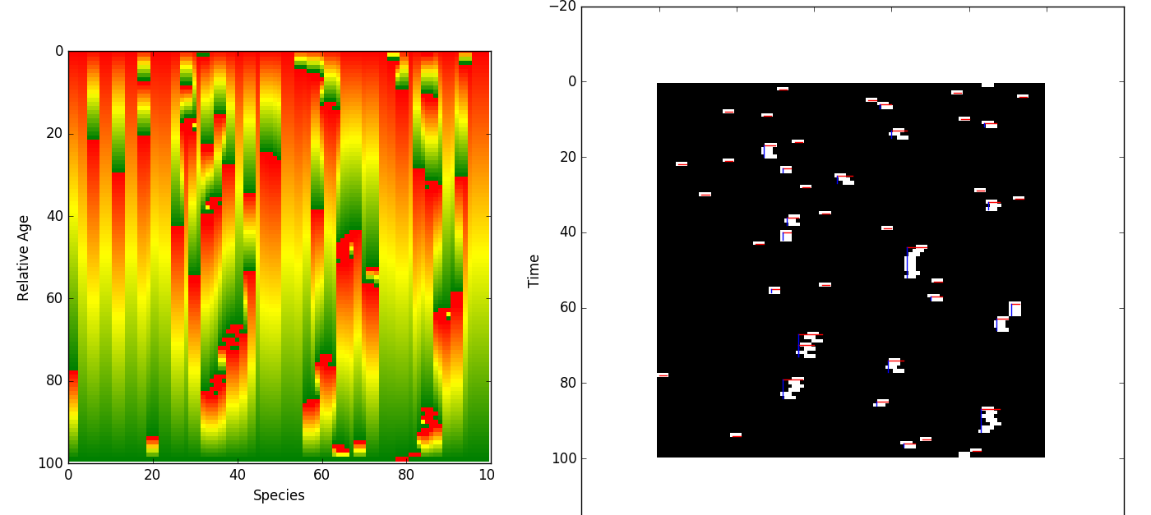
Determination Evolution Branches
Notes:
M [? Min]
The purpose of our project was to develop a tool that can do very fast calculations on transmission. Also the tool had to be interactive, so the user can alter the input and get almost real-time feed back.
This can then be used to investigate molecules and search for promising compositions.
The second part of the project we have used the developed tool to look at graphene nanoribbons, because of their simple 2D structure and the relativistic behavior of the electrons. These nanoribbons could possibly be used in the transistor industry if their properties can be understood and controlled by for example doping.
But before looking into this a proper understanding of the underlying formalisms is required.

